Slide 1

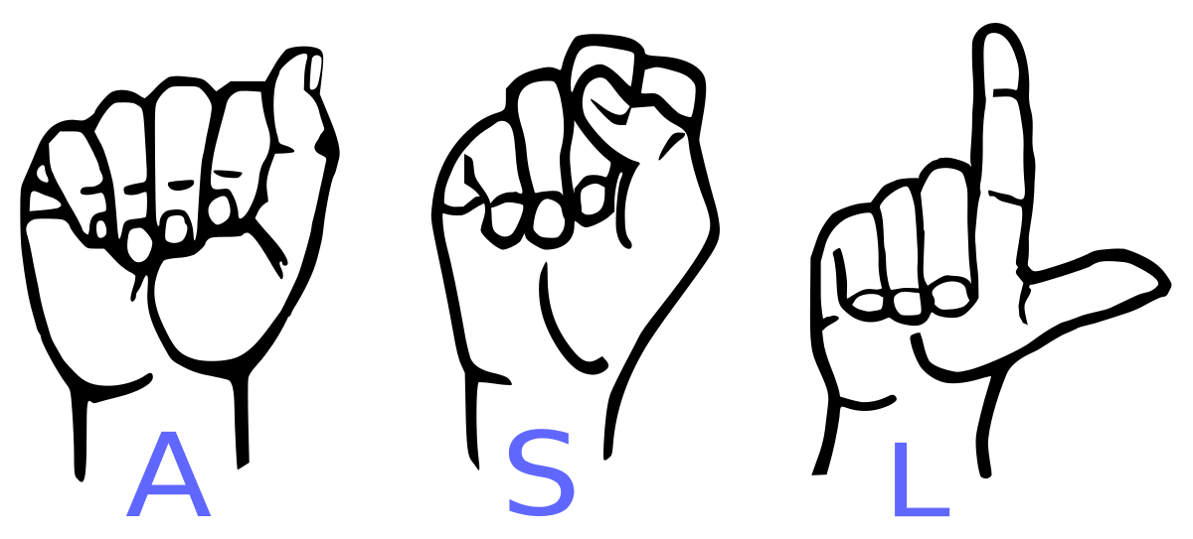
SIGN LANGUAGE TO TEXT/SPEECH
BIRLA VISHVAKARMA MAHAVIDYALAYA ENGINEERING COLLEGE (AN AUTONOMOUS INSTITUTION) INFORMATION TECHNOLOGY DEPARTMENT AY: 2022-23 4IT31 – PROJECT I
GUIDE: DR. NILESH B. PRAJAPATI
TEAM : DEVANSH RAVAL(19IT470), KELVIN PARMAR(19IT473)

Slide 2
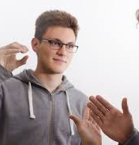
OBJECTIVE
More than 70 million deaf people around the world use sign languages to communicate. Sign language allows them to learn, work, access services, and be included in the communities.
It is hard to make everybody learn the use of sign language with the goal of ensuring that people with disabilities can enjoy their rights on an equal basis with others.
So, the aim is to develop a user-friendly human computer interface (HCI) where the computer understands the American sign language This Project will help the dumb and deaf people by making their life easy.

Slide 3

SCOPE
THIS SYSTEM WILL BE BENEFICIAL FOR BOTH DUMB/DEAF PEOPLE AND THE PEOPLE WHO DO NOT UNDERSTANDS THE SIGN LANGUAGE. THEY JUST NEED TO DO THAT WITH SIGN LANGUAGE GESTURES AND THIS SYSTEM WILL IDENTIFY WHAT HE/SHE IS TRYING TO SAY AFTER IDENTIFICATION IT GIVES THE OUTPUT IN THE FORM OF TEXT AS WELL AS SPEECH FORMAT.

Slide 4
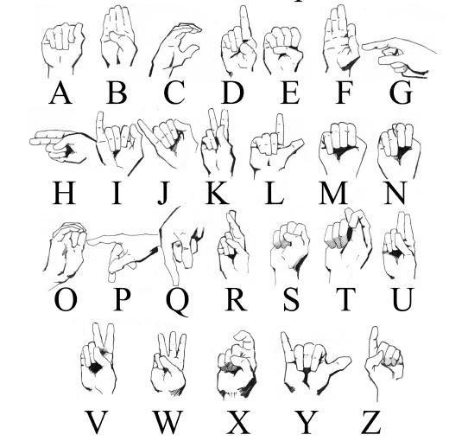
TO CREATE A COMPUTER SOFTWARE AND TRAIN A MODEL USING CNN WHICH TAKES AN IMAGE OF HAND GESTURE OF AMERICAN SIGN LANGUAGE AND SHOWS THE OUTPUT OF THE PARTICULAR SIGN LANGUAGE IN TEXT FORMAT AND CONVERTS IT INTO AUDIO FORMAT AS WELL.
INTRODUCTION

Slide 5
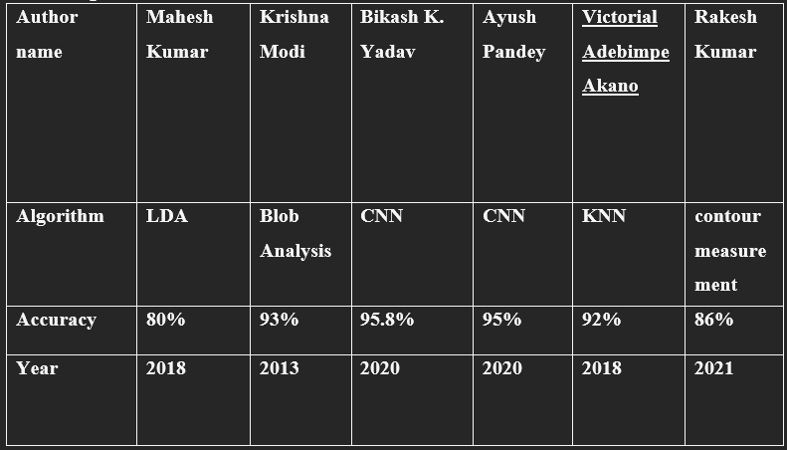
LITERATURE SURVEY

Slide 6
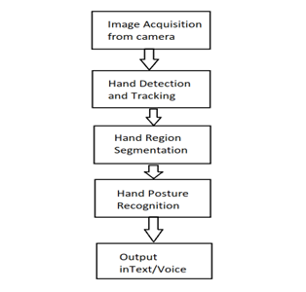
SYSTEM FLOWCHART

Slide 7
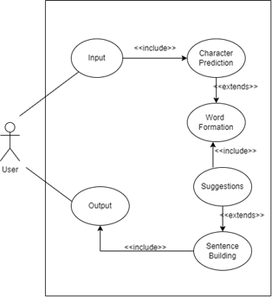
USE-CASE DIAGRAM

Slide 8
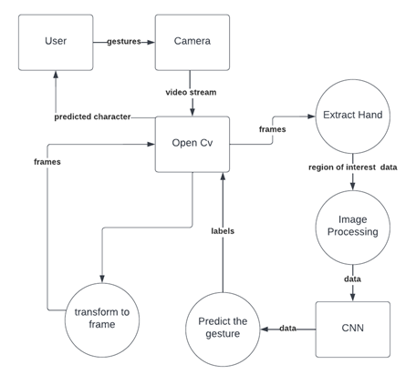
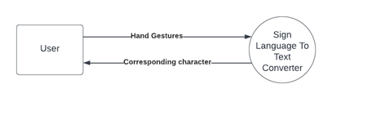
DFD DIAGRAM
LEVEL-1
LEVEL-0

Slide 9
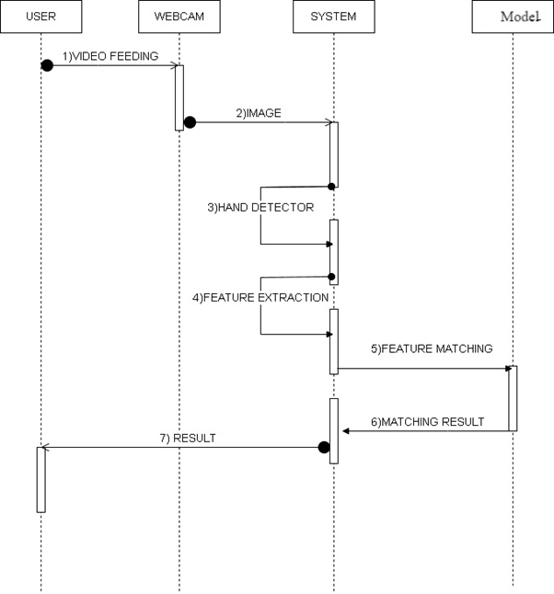
SEQUANCE DIAGRAM

Slide 10
PROJECT MODULES
1.Data Acquisition
2.Data pre-processing and Feature extraction
3.Gesture Classification
4. Text and Speech Translation

Slide 11
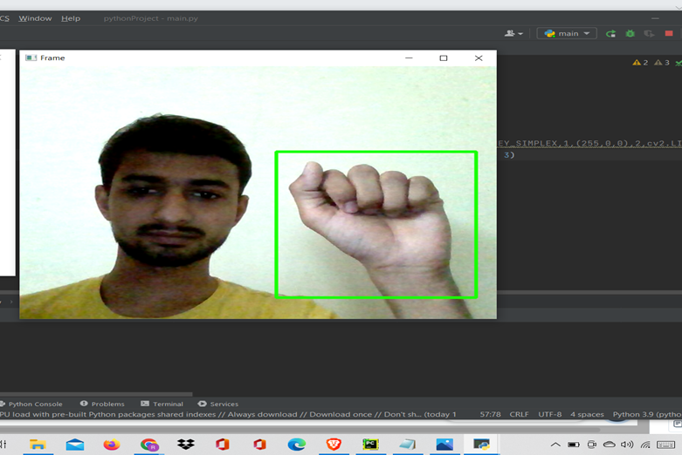
1.DATA ACQUISITION
The different approaches to acquire data about the hand gesture can be done in the following ways:
It uses electromechanical devices to provide exact hand configuration, and position. Different glove-based approaches can be used to extract information. But it is expensive and not user friendly.
In vision-based methods, the computer webcam is the input device for observing the information of hands and/or fingers. The Vision Based methods require only a camera, thus realizing a natural interaction between humans and computers without the use of any extra devices, thereby reducing costs. The main challenge of vision-based hand detection ranges from coping with the large variability of the human hand’s appearance due to a huge number of hand movements, to different skin-color possibilities as well as to the variations in viewpoints, scales, and speed of the camera capturing the scene.

Slide 12
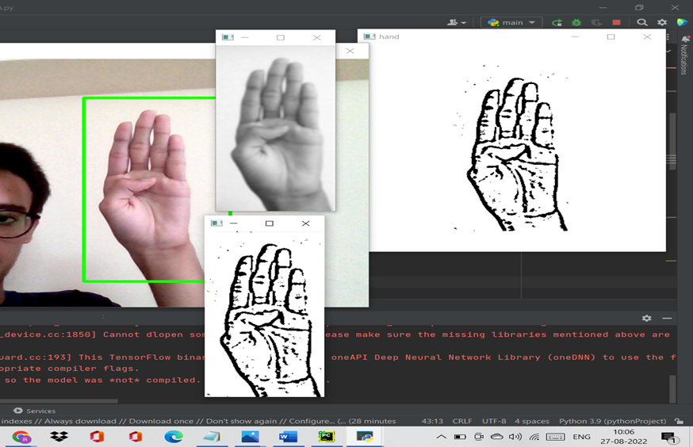
2. DATA PRE-PROCESSING AND FEATURE EXTRACTION
In this approach for hand detection, firstly we detect hand from image that is acquired by webcam and for detecting a hand we used media pipe library which is used for image processing. So, after finding the hand from image we get the region of interest (Roi) then we cropped that image and convert the image to gray image using OpenCV library after we applied the gaussian blur .The filter can be easily applied using open computer vision library also known as OpenCV. Then we converted the gray image to binary image using threshold and Adaptive threshold methods.
We have collected images of different signs of different angles for sign letter A to Z.

Slide 13
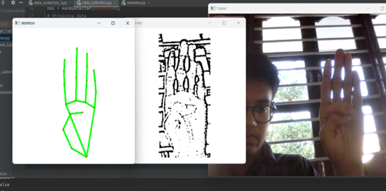
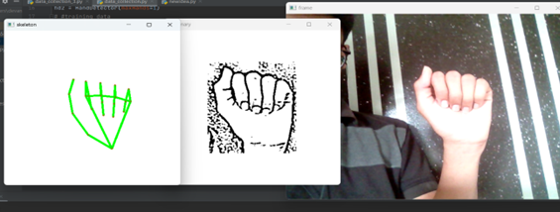
IN THIS METHOD THERE ARE MANY LOOP HOLES LIKE YOUR HAND MUST BE AHEAD OF CLEAN SOFT BACKGROUND AND THAT IS IN PROPER LIGHTNING CONDITION THEN ONLY THIS METHOD WILL GIVE GOOD ACCURATE RESULTS BUT IN REAL WORLD WE DONT GET GOOD BACKGROUND EVERYWHERE AND WE DON’T GET GOOD LIGHTNING CONDITIONS TOO.
SO TO OVERCOME THIS SITUATION WE TRY DIFFERENT APPROACHES THEN WE REACHED AT ONE INTERESTING SOLUTION IN WHICH FIRSTLY WE DETECT HAND FROM FRAME USING MEDIAPIPE AND GET THE HAND LANDMARKS OF HAND PRESENT IN THAT IMAGE THEN WE DRAW AND CONNECT THOSE LANDMARKS IN SIMPLE WHITE IMAGE

Slide 14
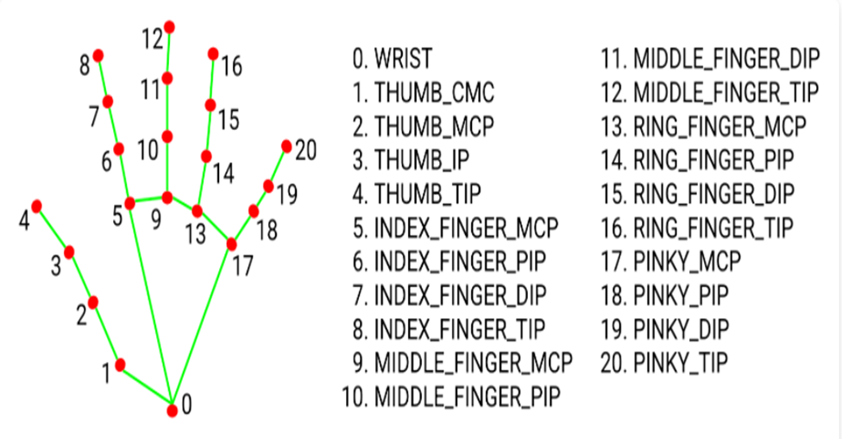
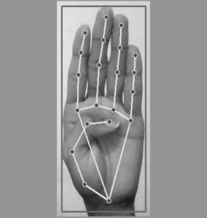
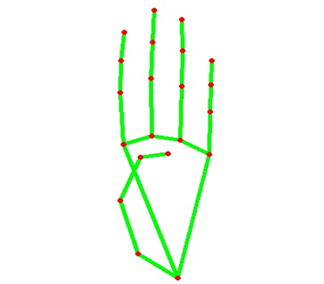
MEDIAPIPE LANDMARK SYSTEM
NOW WE WILL GET THIS LANDMARK POINTS AND DRAW IT IN PLAIN WHITE BACKGROUND USING OPENCV LIBRARY .BY DOING THIS WE TACKLE THE SITUATION OF BACKGROUND AND LIGHTNING CONDITIONS BECAUSE THE MEDIAPIPE LABRARY WILL GIVE US LANDMARK POINTS IN ANY BACKGROUND AND MOSTLY IN ANY LIGHTNING CONDITIONS.
WE HAVE COLLECTED 180 SKELETON IMAGES OF ALPHABETS FROM A TO Z .

Slide 15
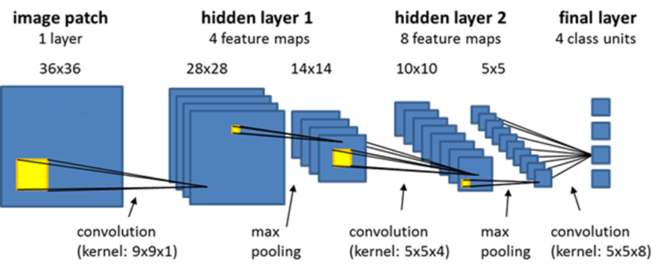
3.GESTURE CLASSIFICATION
CONVOLUTIONAL NEURAL NETWORK (CNN)
CNN IS A CLASS OF NEURAL NETWORKS THAT ARE HIGHLY USEFUL IN SOLVING COMPUTER VISION PROBLEMS. THEY FOUND INSPIRATION FROM THE ACTUAL PERCEPTION OF VISION THAT TAKES PLACE IN THE VISUAL CORTEX OF OUR BRAIN. THEY MAKE USE OF A FILTER/KERNEL TO SCAN THROUGH THE ENTIRE PIXEL VALUES OF THE IMAGE AND MAKE COMPUTATIONS BY SETTING APPROPRIATE WEIGHTS TO ENABLE DETECTION OF A SPECIFIC FEATURE. CNN IS EQUIPPED WITH LAYERS LIKE CONVOLUTION LAYER, MAX POOLING LAYER, FLATTEN LAYER, DENSE LAYER, DROPOUT LAYER AND A FULLY CONNECTED NEURAL NETWORK LAYER. THESE LAYERS TOGETHER MAKE A VERY POWERFUL TOOL THAT CAN IDENTIFY FEATURES IN AN IMAGE. THE STARTING LAYERS DETECT LOW LEVEL FEATURES THAT GRADUALLY BEGIN TO DETECT MORE COMPLEX HIGHER-LEVEL FEATURES
BY THE END OF THE CNN ARCHITECTURE WE WILL REDUCE THE FULL IMAGE INTO A SINGLE VECTOR OF CLASS SCORES.

Slide 16
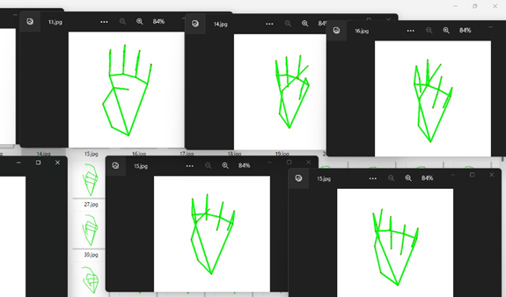
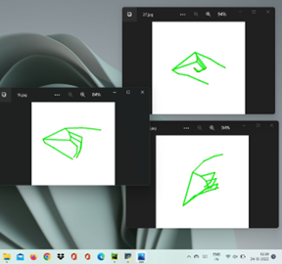
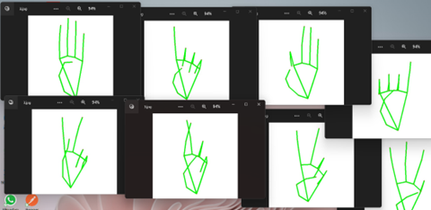
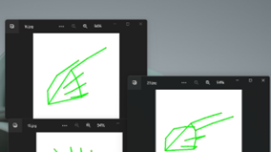
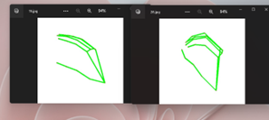
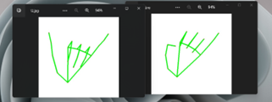
THE PREPROCESSED 180 IMAGES/ALPHABET WILL FEED THE KERAS CNN MODEL.
BECAUSE WE GOT BAD ACCURACY IN 26 DIFFERENT CLASSES THUS, WE DIVIDED WHOLE 26 DIFFERENT ALPHABETS INTO 8 CLASSES IN WHICH EVERY CLASS CONTAINS SIMILAR ALPHABETS:
ALL THE GESTURE LABELS WILL BE ASSIGNED WITH A
PROBABILITY. THE LABEL WITH THE HIGHEST PROBABILITY WILL TREATED TO BE THE PREDICTED LABEL.
SO WHEN MODEL WILL CLASSIFY [AEMNST] IN ONE SINGLE CLASS USING MATHEMATICAL OPERATION ON HAND LANDMARKS WE WILL CLASSIFY FURTHER INTO SINGLE ALPHABET A OR E OR M OR N OR S OR T.

Slide 17
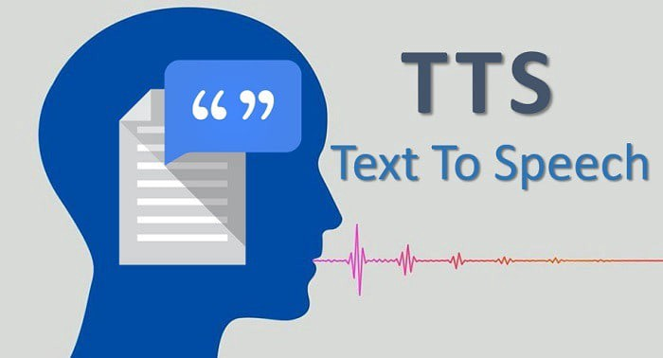
4. TEXT TO SPEECH TRANSLATION
THE MODEL TRANSLATES KNOWN GESTURES INTO WORDS. WE HAVE USED PYTTSX3 LIBRARY TO CONVERT THE RECOGNIZED WORDS INTO THE APPROPRIATE SPEECH. THE TEXT-TO-SPEECH OUTPUT IS A SIMPLE WORKAROUND, BUT IT'S A USEFUL FEATURE BECAUSE IT SIMULATES A REAL-LIFE DIALOGUE.

Slide 18
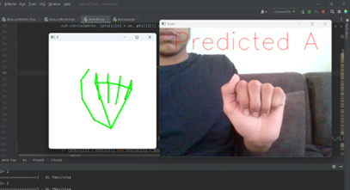
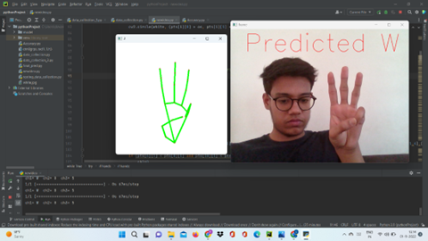
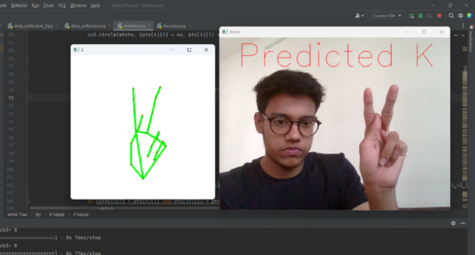
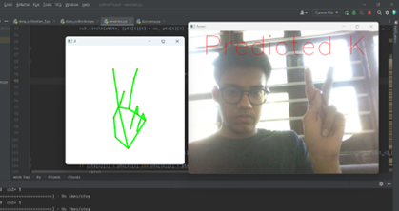
IMPLEMENTATION AND TESTING
HERE ARE SOME SNAPSHOTS WHEN USER SHOWS SOME HAND GESTURES IN DIFFERENT BACKGROUND AS WELL AS IN DIFFERENT LIGHTNING CONDITIONS AND SYSTEM IS GIVING CORRESPONDING PREDICTION.

Slide 19
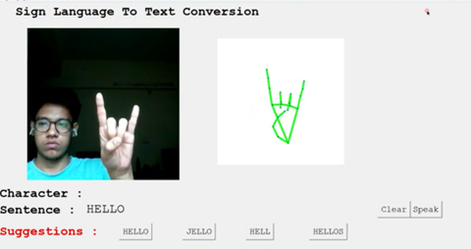
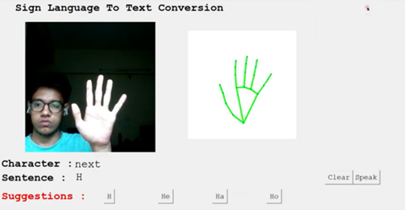
After Implementing the cnn algorithm we made gui using python Tkinter and add Suggestions also to make the process smooth for user.
Below shown sign is used for giving space between words.
BELOW SHOWN SIGN IS USED AFTER PREDICTING EACH ALPHABET TO MOVE FURTHER

Slide 20
CONCLUSION AND FUTURE WORK
FINALLY, WE ARE ABLE TO PREDICT ANY ALPHABET[A-Z] WITH 97% ACCURACY (WITH AND WITHOUT CLEAN BACKGROUND AND PROPER LIGHTNING CONDITIONS) THROUGH OUR METHOD. AND IF THE BACKGROUND IS CLEAR AND THERE IS GOOD LIGHTNING CONDITION THEN WE GOT EVEN 99% ACCURATE RESULTS.
IN FUTURE WORK WE WILL MAKE ONE ANDROID APPLICATION IN WHICH WE IMPLEMENT THIS ALGORITHM FOR GESTURE PREDICTION.

Slide 21
THANK YOU

